Slide 1
Artificial Intelligence Patent Dataset Analysis
Final Project
Prisha Dipesh Singhania
Changho Jung
Month Year

Slide 2
Index
Introduction
Datasets Explanation
Hypothesis - Part 1
Hypothesis - Part 2
Hypothesis - Part 3
Hypothesis - Part 4
Future work & Challenges

Slide 3
Introduction
The geographic distribution of US patent filings reflects broader economic & technological shifts.
This hypothesis explores how major events or assumptions
the COVID-19 pandemic
relationship with institutes
types of patent filers
Technological booms such as AlexNet in 2012 and Generative AI in 2022
Financial crisis in 2008 (WIP)
and the ongoing decentralization of tech innovation
have impacted patent location trends in the US (We plan to use only the patents granted datasets for all the following criterias)

Slide 4
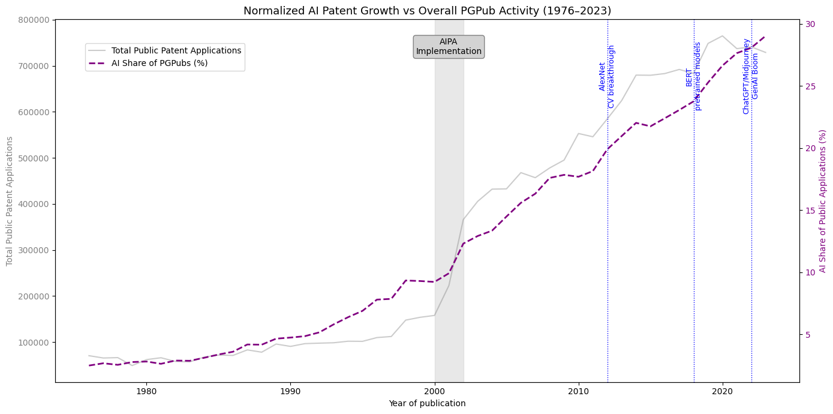
Introduction

Slide 5
Dataset
5 Patent related datasets are from PatentsView (more than 8GB of Data)
g_location_disambiguated.tsv (location info)
g_inventor_disambiguated.tsv (individual inventors’ info)
g_application.tsv (individual patent applications)
g_attorney_disambiguated.tsv (attorneys in charge of patent application)
g_assignee_disambiguated.tsv (assigned organization info)
2 External datasets related with university location and rank of research spending
Colleges_and_Universities_-3122497483864735259.csv (university locations)
2025-Public-Data-File.xlsx (university types)

Slide 6
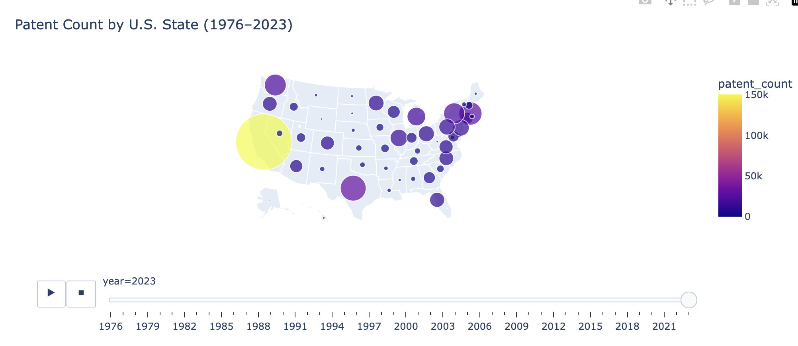
Showcase Interactive Slider

Slide 7
Hypothesis - Part 1
1. Post-COVID Spatial Dispersion of Innovation
We hypothesize that the geographic distribution of patent filings in the U.S. became more dispersed after the COVID-19 pandemic (2020–2021).
This may be due to increased remote work flexibility, allowing inventors to file from less traditional, non-urban tech hubs. We expect to observe more filings from rural or non-coastal counties in the post-2021 period.

Slide 8
Hypothesis - Part 1
Merged 4 datasets to make an appropriate dataset
FIPS System of Labelling the County and State (2 digits for the state and 3 for the county)
Showcase Chart for year 2018
Showcase chart for year 2022
Findings from the two years

Slide 9
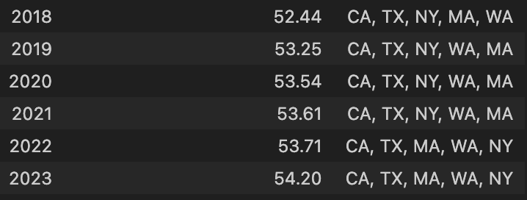
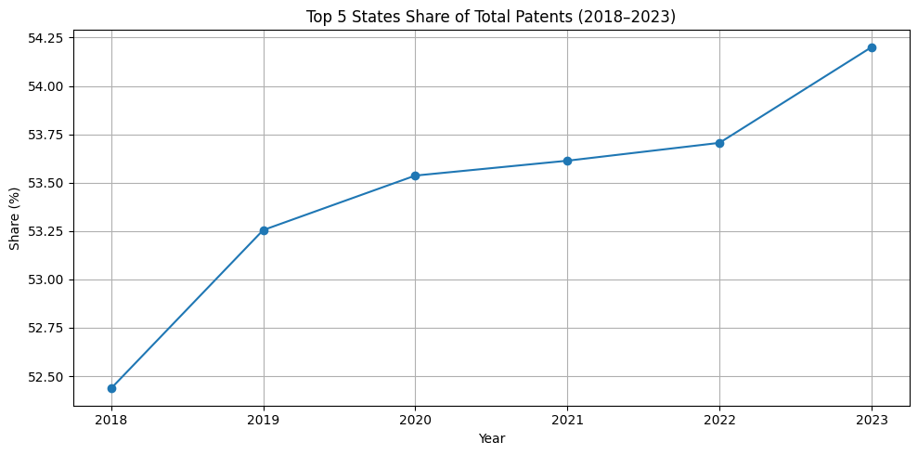
Hypothesis - Part 1
Statistical Analysis - 1
California
Texas
New York
Washington
Massachusetts

Slide 10
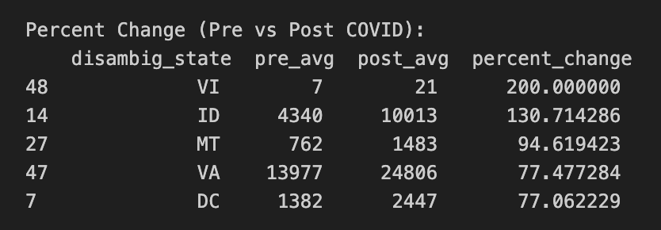
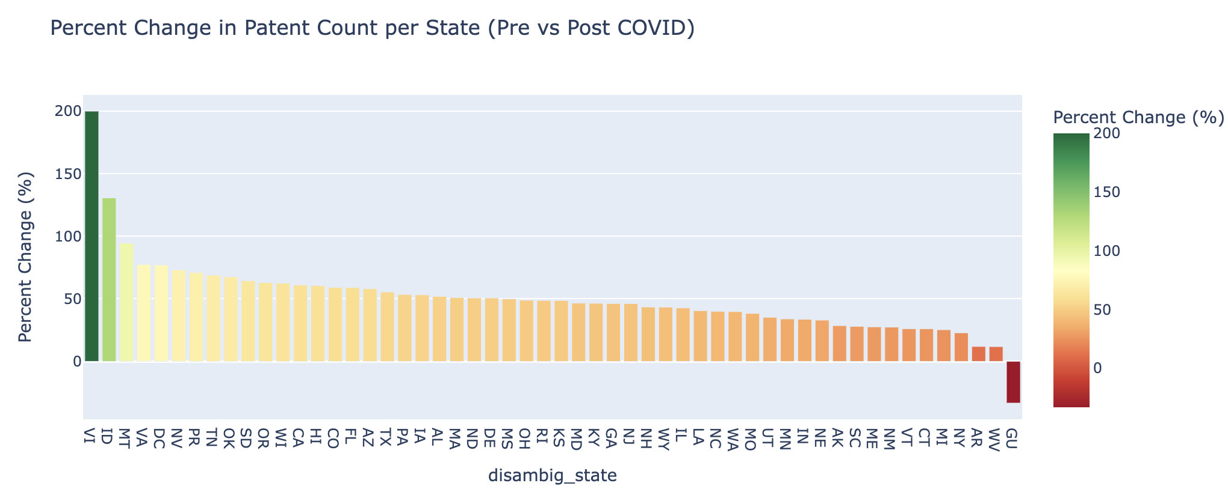
Hypothesis - Part 1
Statistical Analysis - 2
Virgin Islands
Idaho
Montana
Virginia
Districts of Columbia
Interactive Slider with selection possible

Slide 11
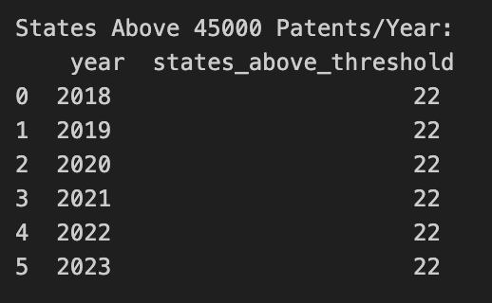
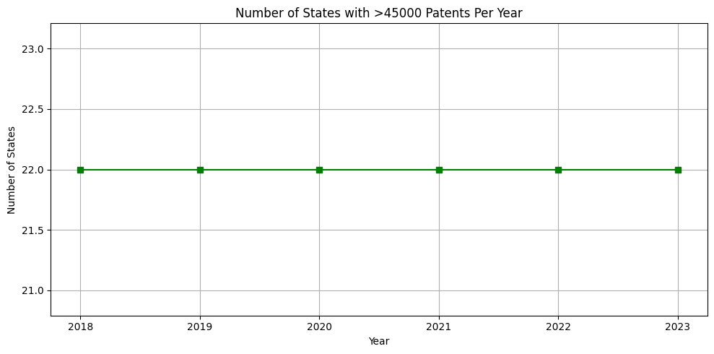
Hypothesis - Part 1
Statistical Analysis - 3

Slide 12
Hypothesis - Part 2
2. Proximity to Research Institutions and Patent Density
We expect that counties with prominent research universities (e.g., Stanford, MIT, UIUC) consistently see higher patent activity.
This hypothesis explores whether proximity to academic research hubs correlates with innovation output.
Methods: Scatter map, density map by county, summary statistics on patent activity by county

Slide 13
Hypothesis - Part 2
2. Proximity to Research Institutions and Patent Density
Show case: Scatter map
Dataset subsetted by around 1/20 due to large sample size (n>10M)
Red stars: Very high top research spending universities
Blue dots: inventor’s patent activities
Result - Looks like patent activities occurred around research universities

Slide 14
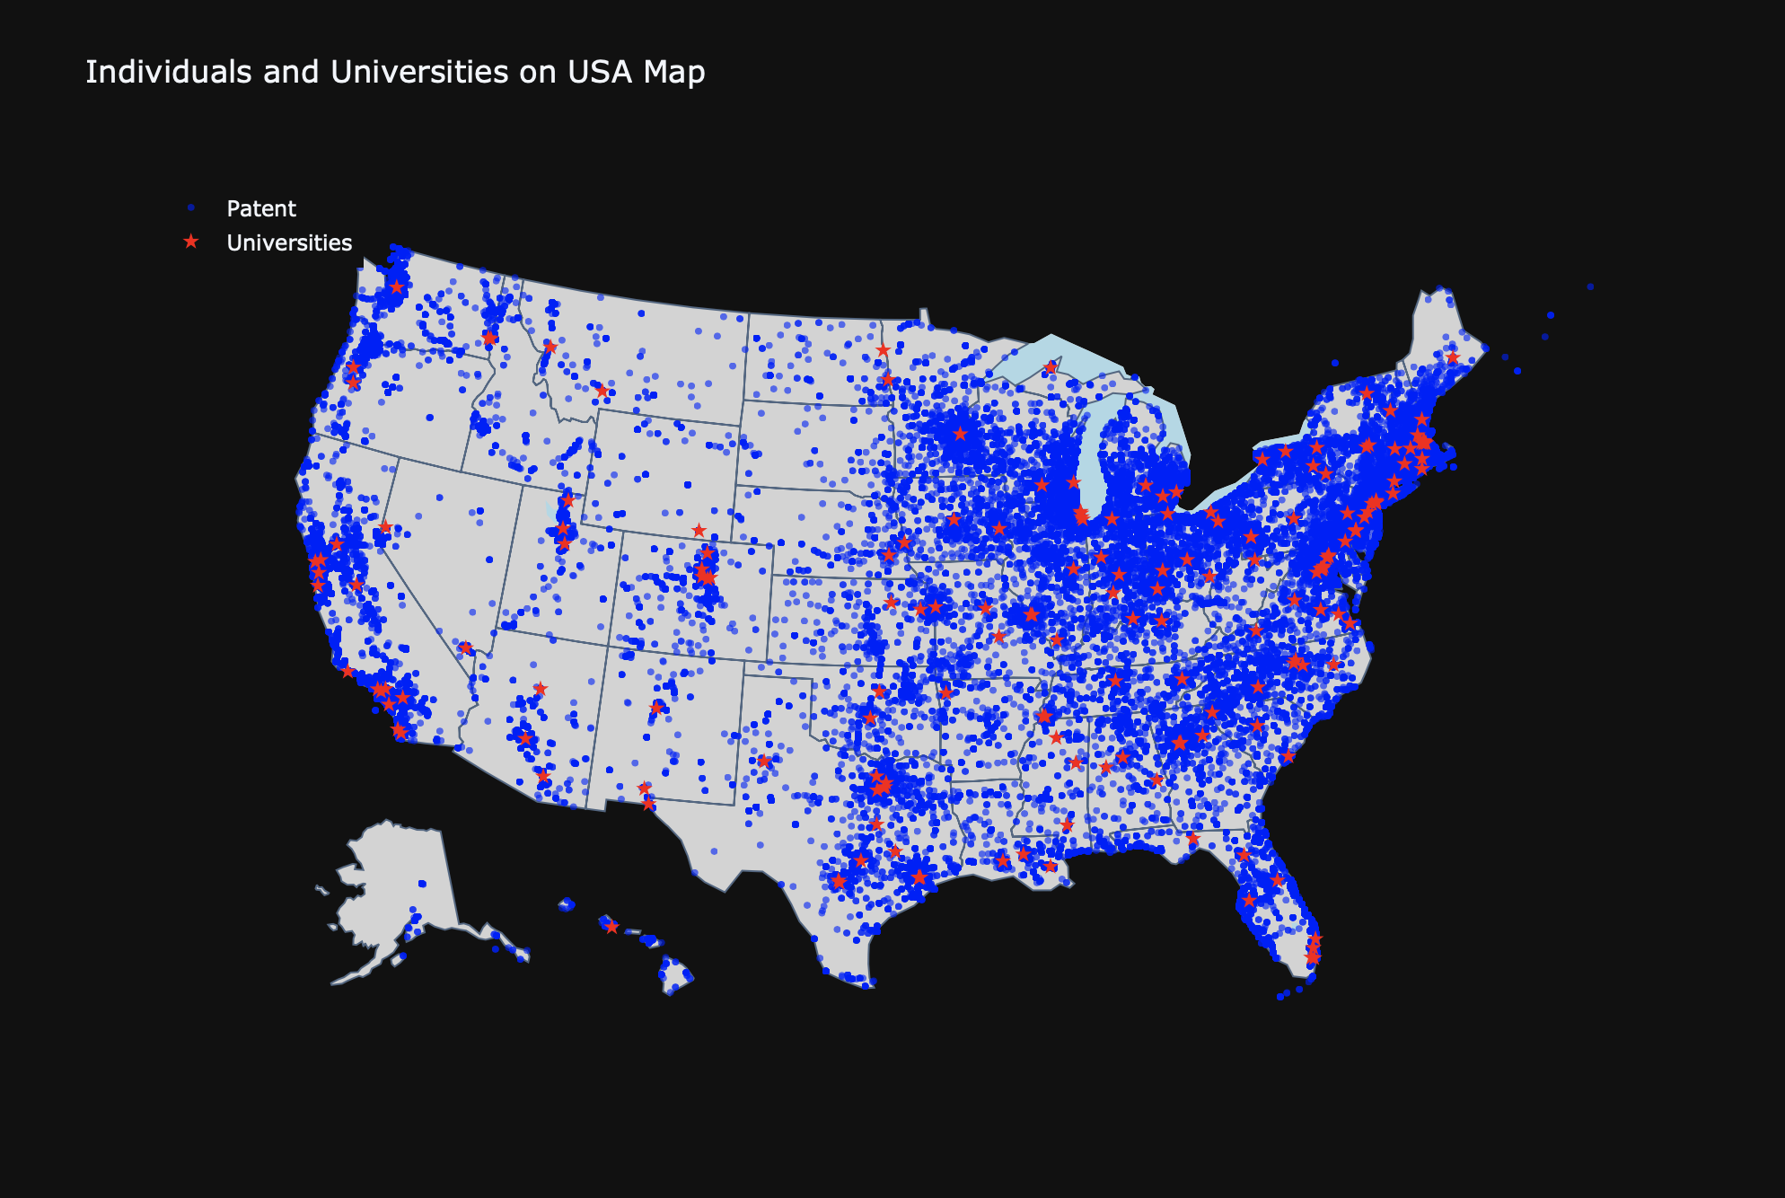

Slide 15
Hypothesis - Part 2
2. Proximity to Research Institutions and Patent Density
Showcase: Country density plot
Red stars: Very high top research spending universities
Result - Looks like patent activities occurred in counties with research universities

Slide 16
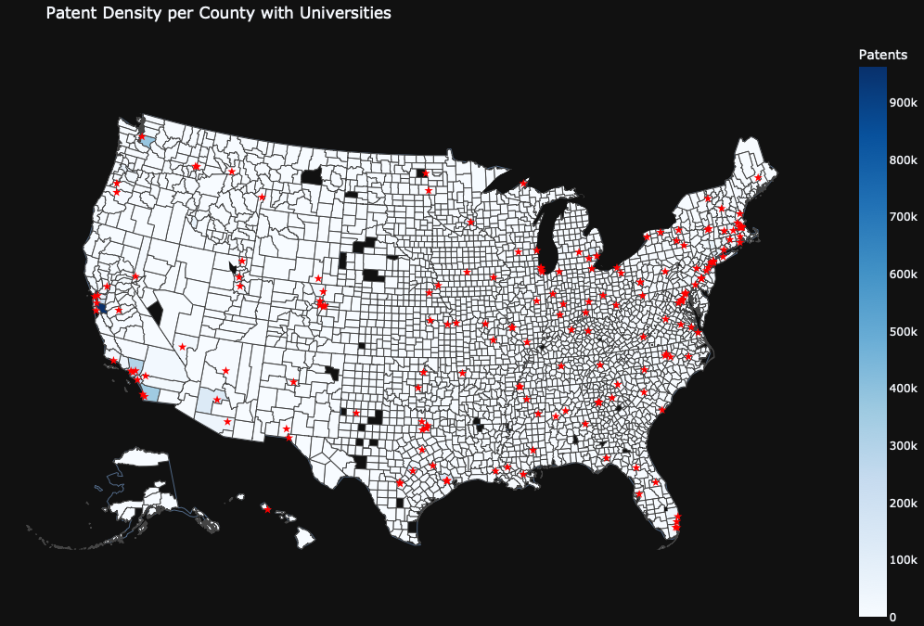

Slide 17

Hypothesis - Part 2
2. Proximity to Research Institutions and Patent Density
Grouped by whether counties contains research university or not
High standard deviation
Can see high mean (but high SD), median for 13K, with higher number for quantiles.
Higher patent activities around research universities, support part 2 of hypothesis

Slide 18
Hypothesis - Part 3
3. Attorney Involvement and technologically advanced states
We hypothesize that patents filed with attorney organizations involvement are more likely to originate from tech-centric states due to legal infrastructure present.
In contrast, patents without attorney organization involvement may show more geographic spread in rural origin.

Slide 19
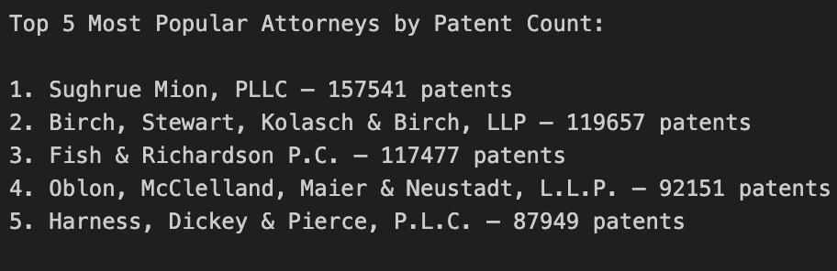
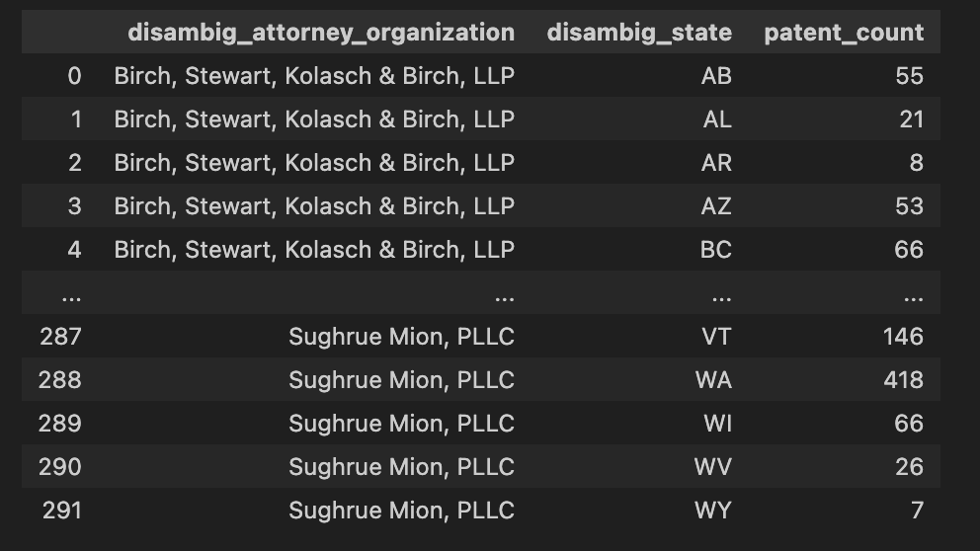
Hypothesis - Part 3

Slide 20
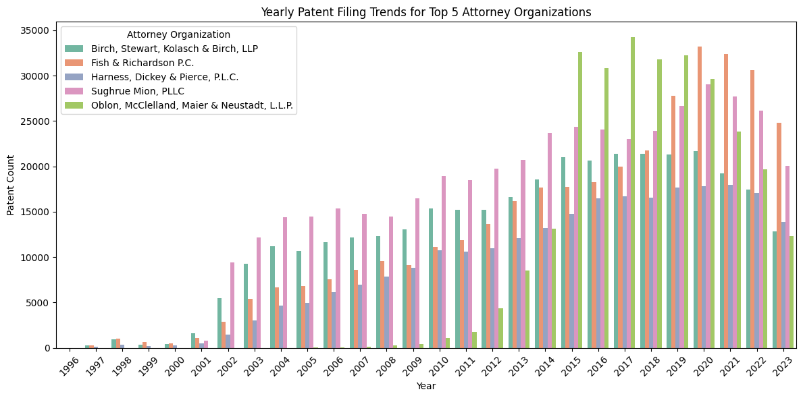
Hypothesis - Part 3

Slide 21
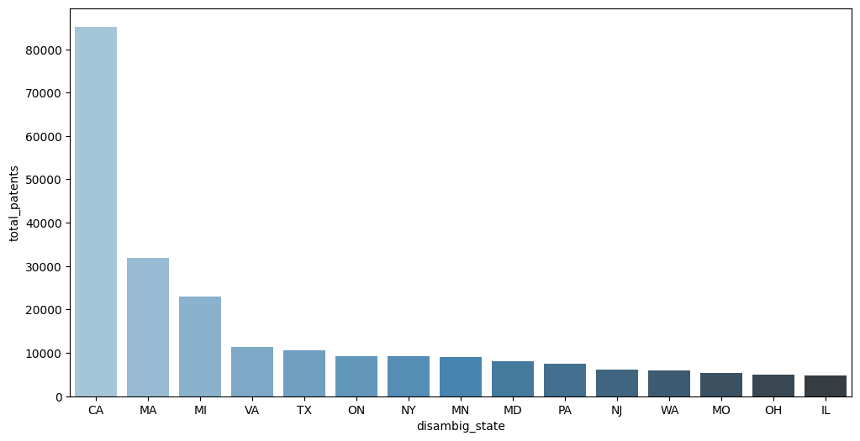
Hypothesis - Part 3
California
Montana
Michigan
Virginia
Texas
Total patents requiring attorney for the top 10 states

Slide 22
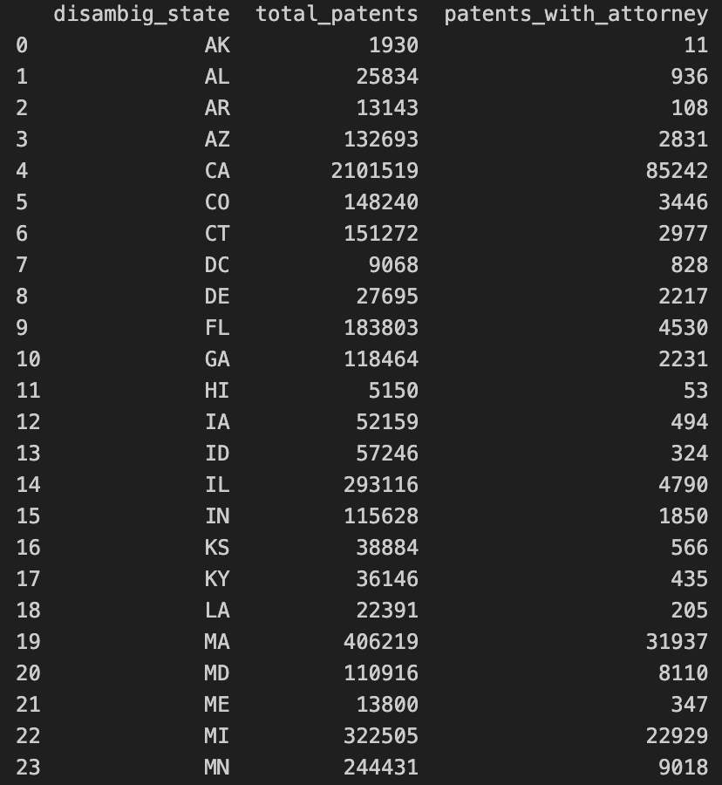
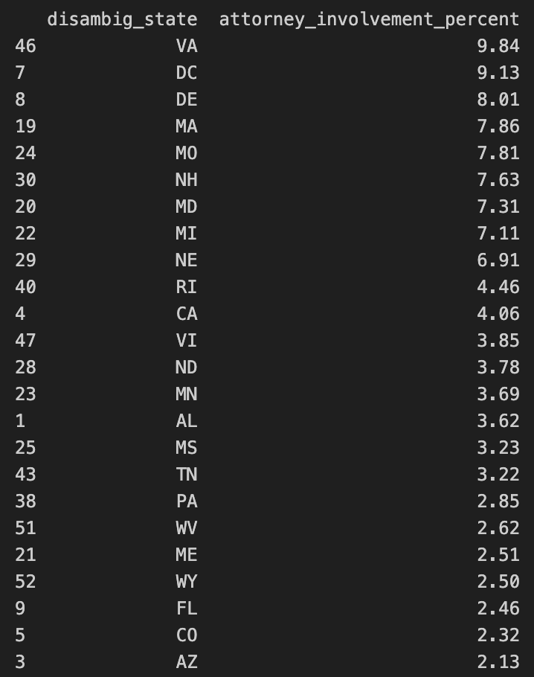
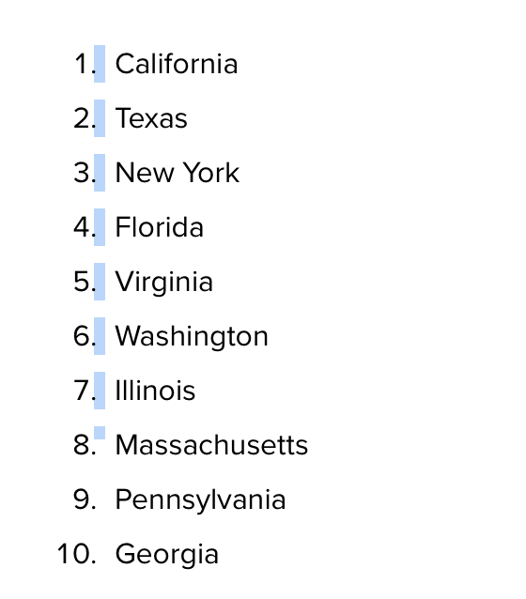
Hypothesis - Part 3
Referneces - https://www.monster.com/career-advice/article/tech-jobs-easiest-states-hire

Slide 23
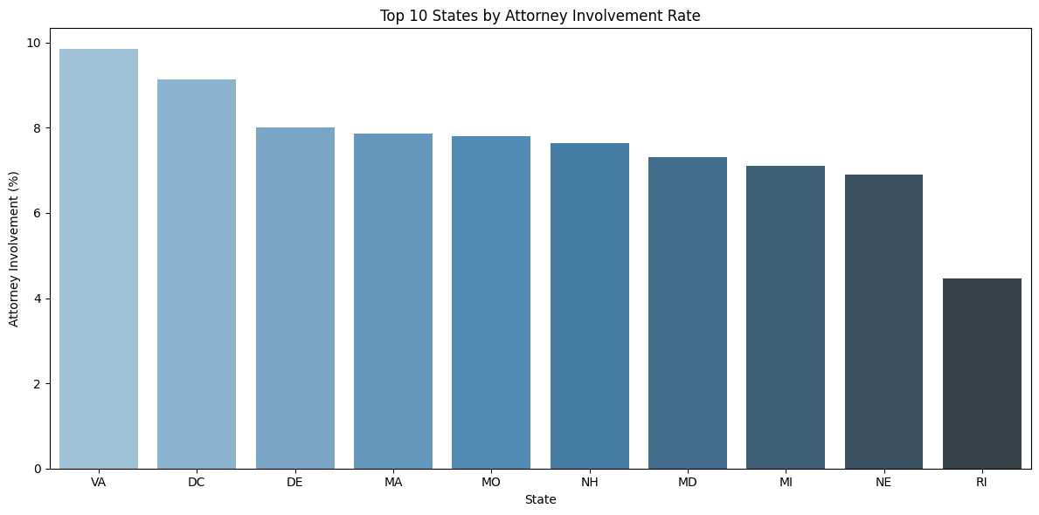
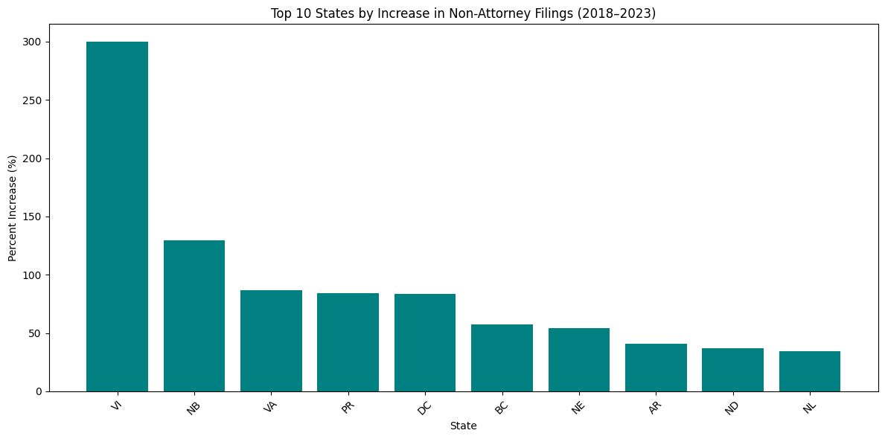
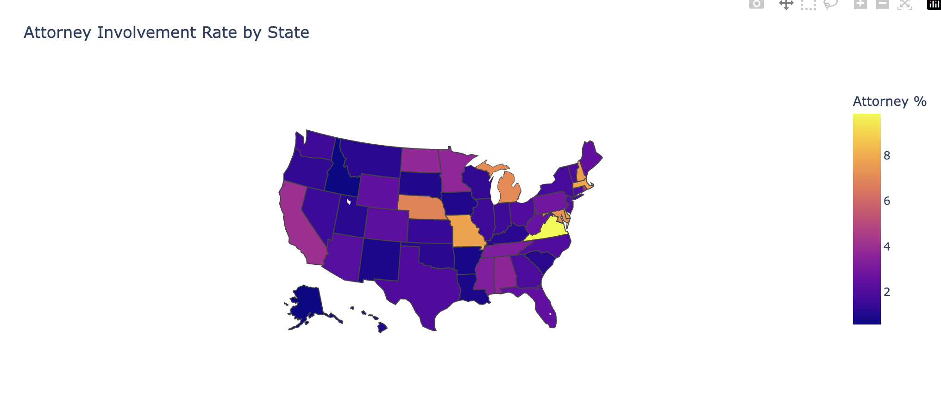
Hypothesis - Part 3
Virginia
District of Columbia
Delaware
Montana
Missouri

Slide 24
Hypothesis - Part 3

Slide 25
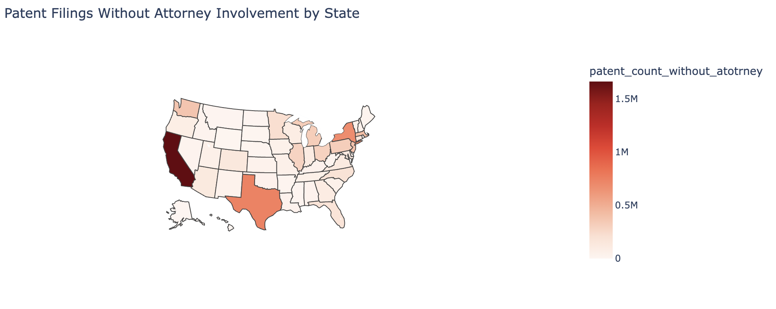
Hypothesis - Part 3

Slide 26
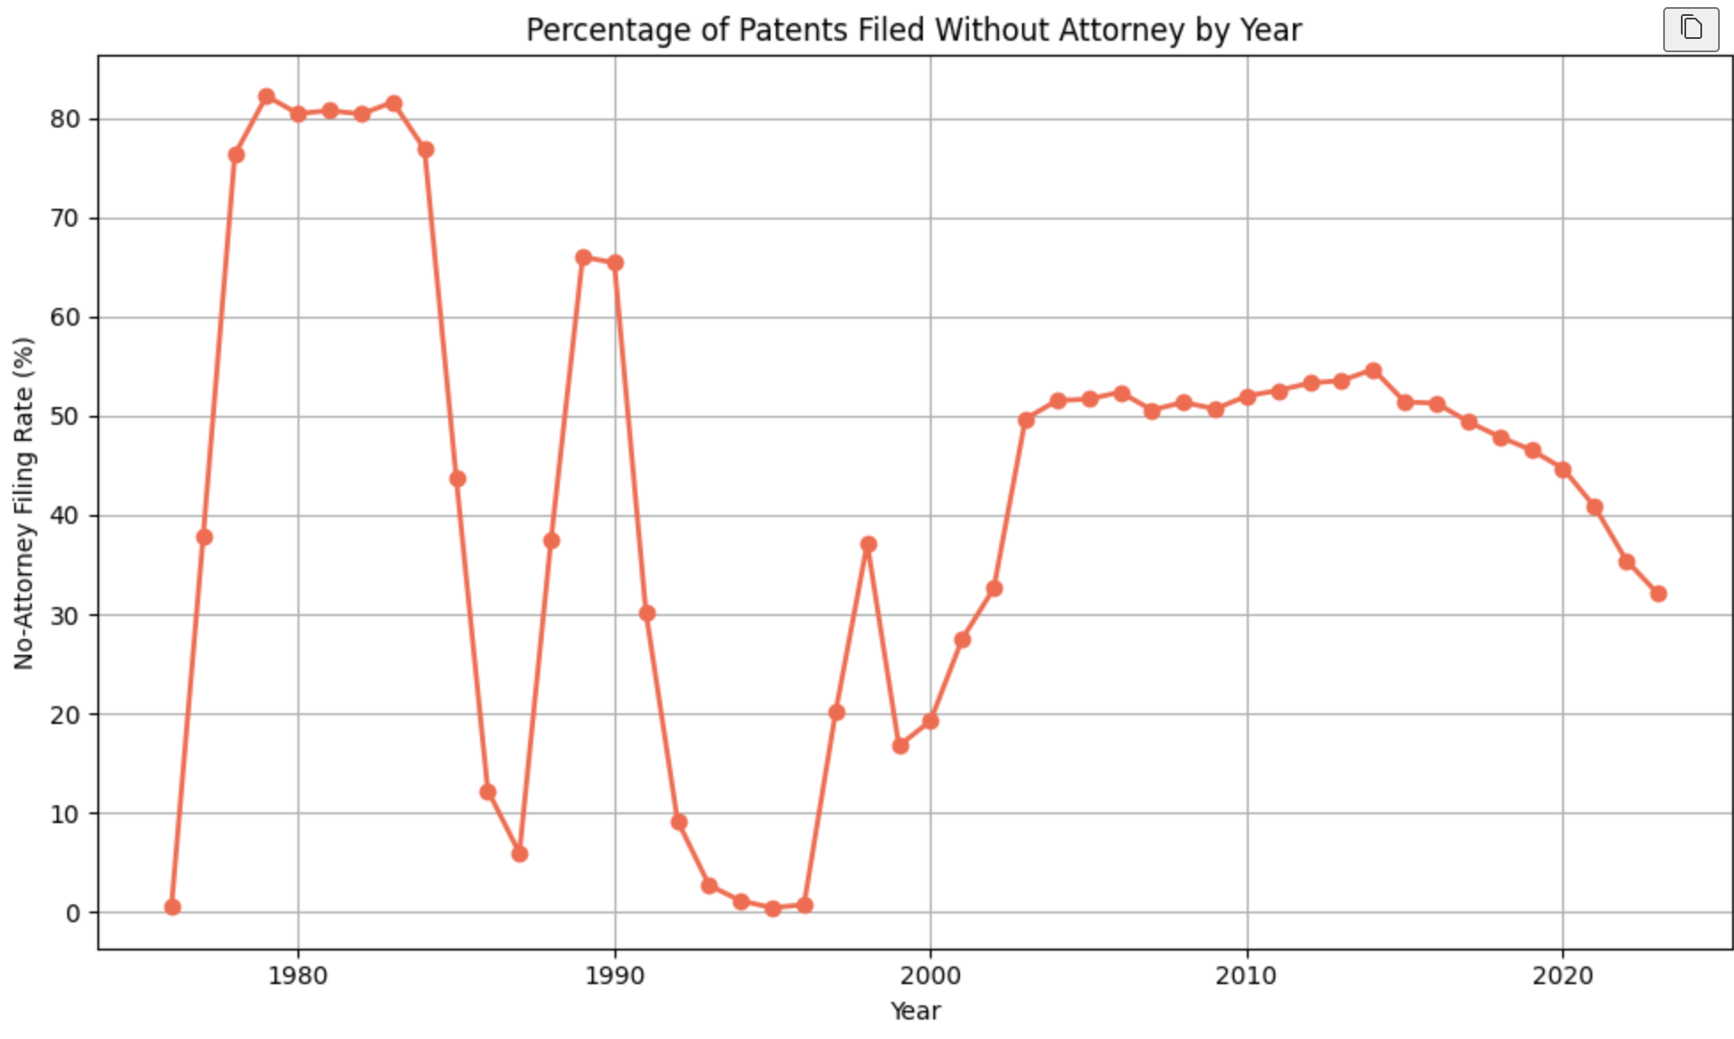
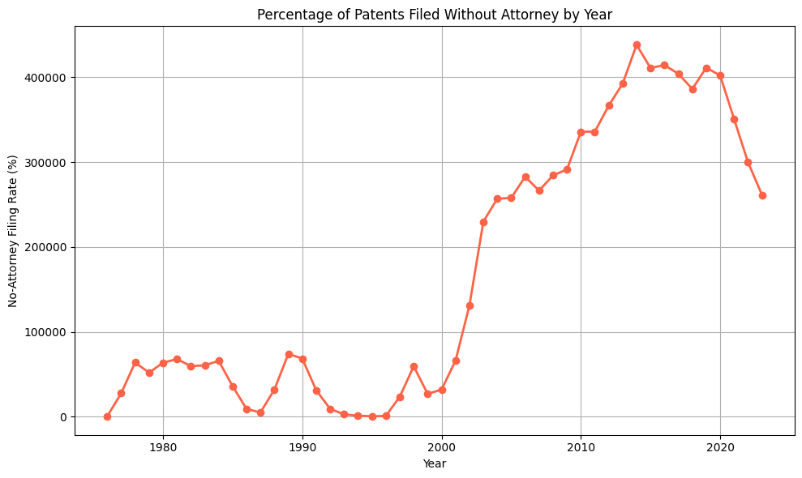
Hypothesis - Part 3

Slide 27

Hypothesis - Part 3
Virgin Islands
New Brunswick
Virginia
Puerto Rico
District of Columbia

Slide 28
Hypothesis - Part 4
4. Assignee Type and Geographic Concentration
We hypothesize that patents assigned to organizations (companies, universities, government) show a more concentrated geographic footprint compared to patents with individual or no clear assignee.
Specifically, we expect corporate-assigned patents to cluster around business hubs (California and New York), while individually filed patents may appear more dispersed.
Methods: Scatter map, density map, and stacked bar plot

Slide 29
Hypothesis - Part 4
4. Assignee Type and Geographic Concentration
Showcase: Scatter maps
Dataset subsetted by around 1/20 due to large sample size (n>10M)
Unclear about organizations are centered in urban area compare to the individual

Slide 30
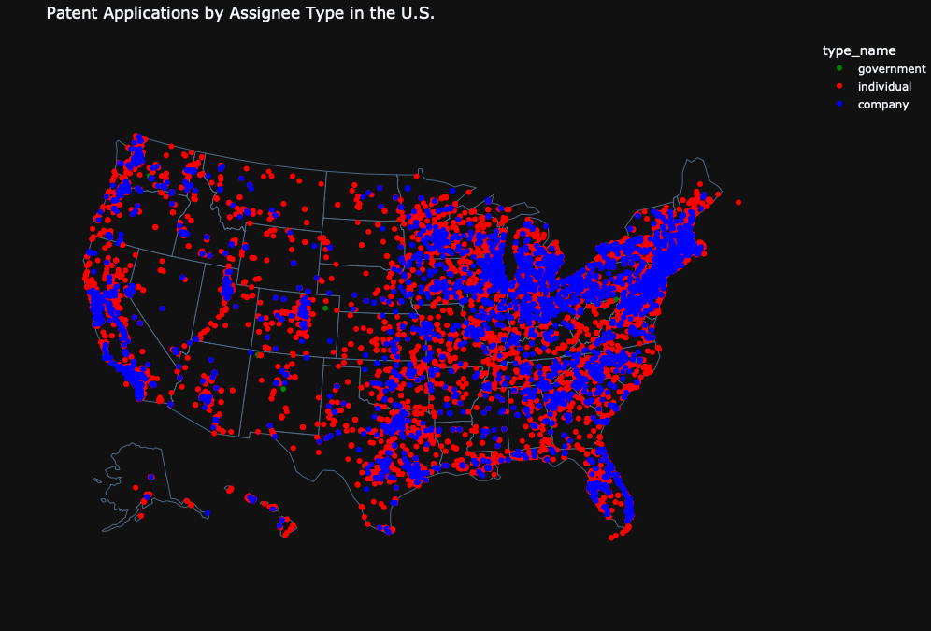

Slide 31
Hypothesis - Part 4
4. Assignee Type and Geographic Concentration
Showcase: Density map with dominant category
Density map for individual and company shows companies are more spreaded
Density map with dominant patent assignee showed
Individuals are majority if subset company with same size of individual patents
Companies are majority if use full dataset
Still hard to find result that Companies are more centered in urban area than the individual do

Slide 32
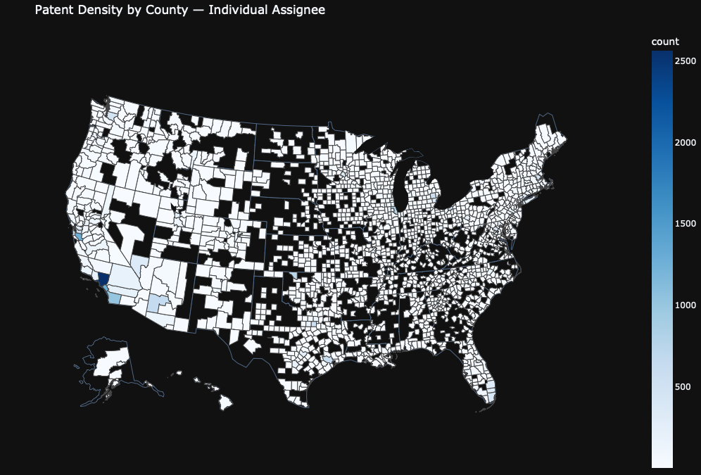

Slide 33
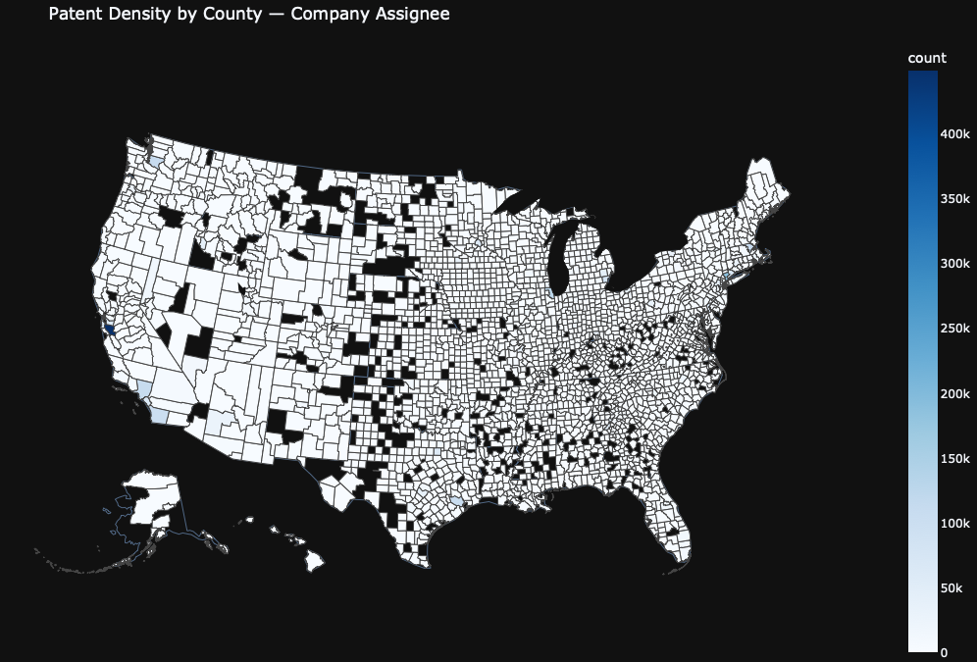

Slide 34
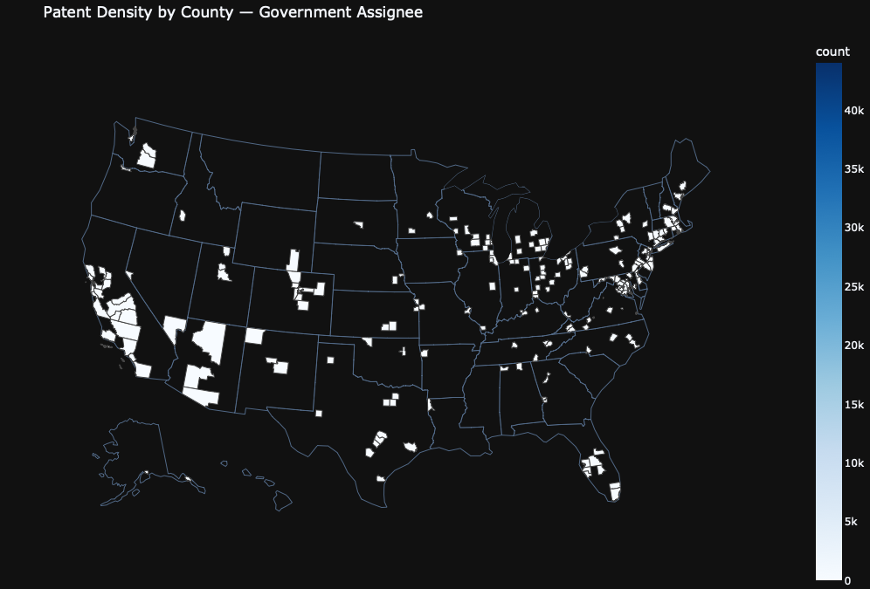

Slide 35
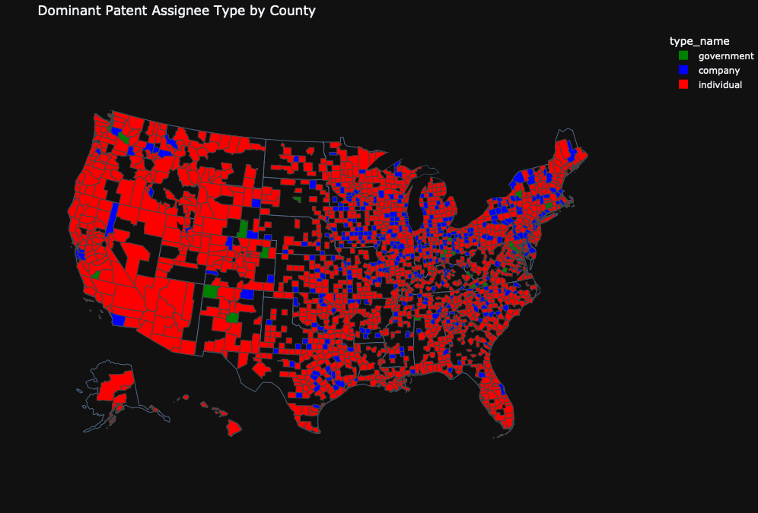

Slide 36
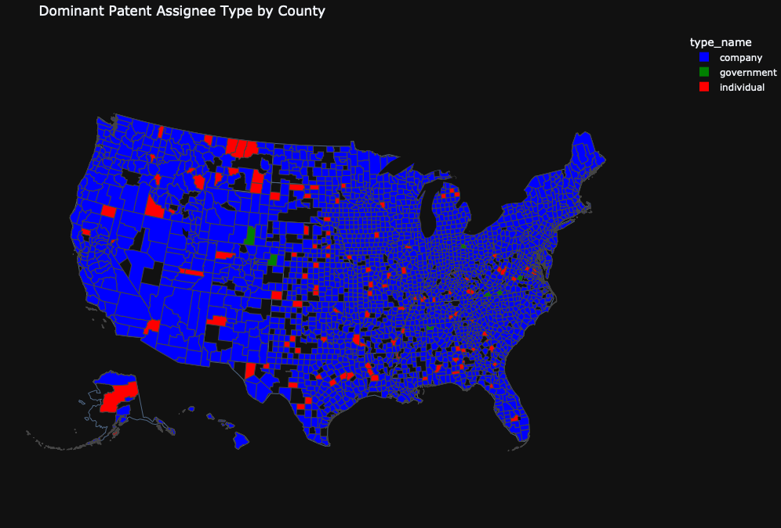

Slide 37
Hypothesis - Part 4
4. Assignee Type and Geographic Concentration
Showcase: Density stack bar plot
We can clearly see companies’ patent activity indeed centered states like California and New York.
However, is was the similar for individual patent activity
Hard to say organizations are more concentrated
A: Reject hypothesis as company more spreaded (density map), and individuals are also centered in the urban area (bar plot)

Slide 38
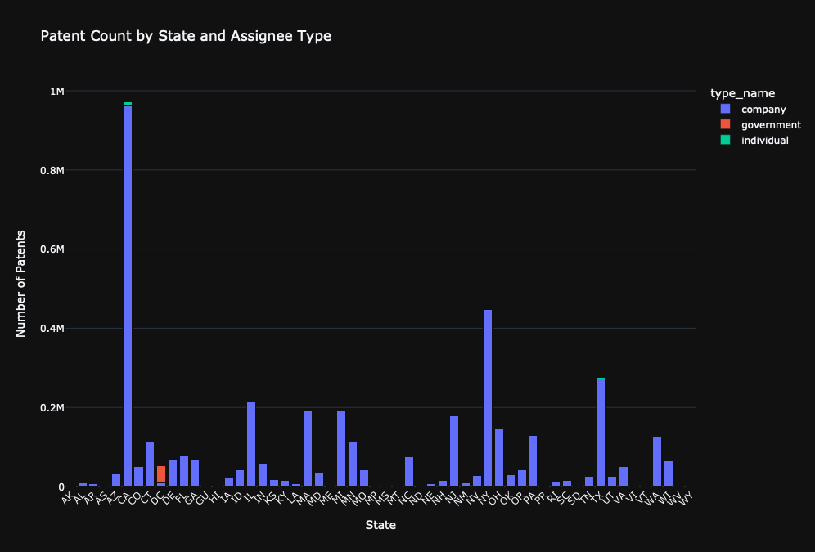

Slide 39
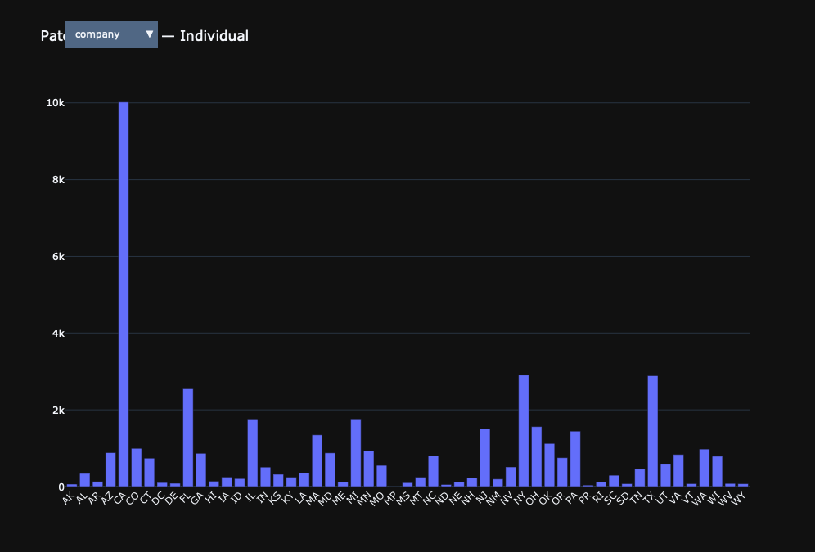

Slide 40
Challenges & Future works
Write a code for automatically check and download huge datasets
Write code more efficiently, try to create function for repetitive codes
Thought of 2 new hypothesis
Financial Crisis in 2008
One time patent filler trends over years
Writing doctests for the functions in the code
Well, our kernel died a multiple times when trying to merge 5 datasets to get the optimal dataset for analysis
A lot of points (>4,00,000) which made it difficult to visualize a lot of analysis so several groupings had to be done
FRAMING HYPOTHESES - THE MOST REAL CHALLENGE for us

